Slide 1
Session 1: Introduction to Machine Learning in Finance

Slide 2
Analytics
Notes:
What is
Data Science Project Life-cycle?
Data Products?
Data Engineering?
https://www.datasciencecentral.com/profiles/blogs/the-data-science-project-lifecycle
https://www.dezyre.com/article/life-cycle-of-a-data-science-project/270
https://docs.microsoft.com/en-us/azure/machine-learning/team-data-science-process/overview
https://www.dataquest.io/blog/what-is-a-data-engineer/
https://cognitiveclass.ai/blog/data-scientist-vs-data-engineer/
http://www.juiceanalytics.com/writing/turning-data-into-product
https://www.safaribooksonline.com/library/view/data-analytics-with/9781491913734/ch01.html
https://sloanreview.mit.edu/article/designing-and-developing-analytics-based-data-products/
[Carsten Bange] http://www.digitalistmag.com/cio-knowledge/2016/11/07/building-data-products-realize-data-driven-business-models-04635900
Data Project Lifecycle
1.1 Understand the different stages of data project life cycle 1.2 Explore data from different sources 1.3 Discuss the impact of implementing data in an organisation 1.4 Understand the types of data products
Data Management
Data Engineering

Slide 3
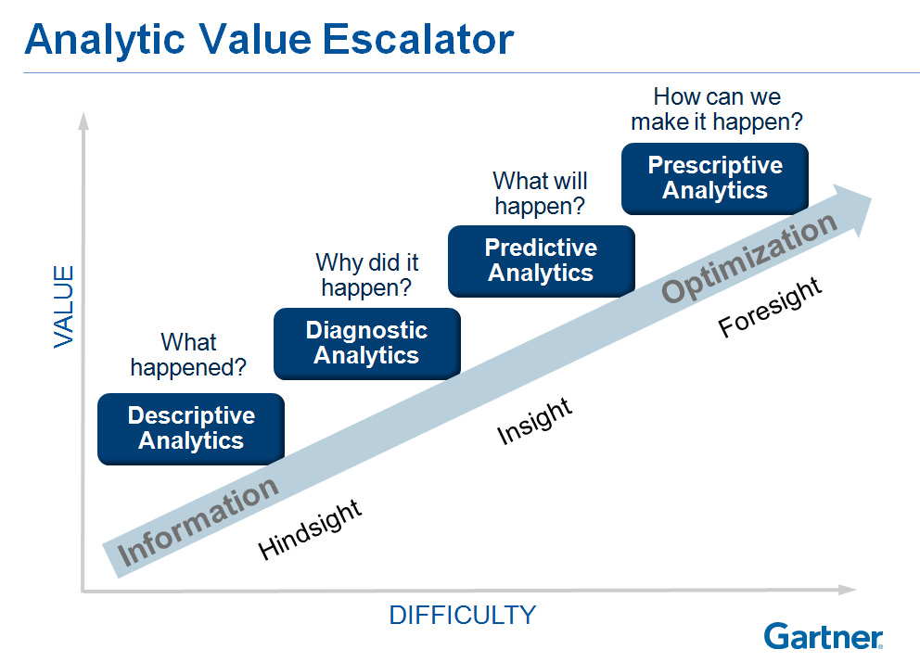
Types of Analytics
Notes:
https://www.flickr.com/photos/27772229@N07/8267855748

Slide 4
Types of Analytics
Descriptive Analytics
Make use of data aggregation and data mining to provide insight into the past and answer: “What has happened?”
Predictive Analytics
Make use of statistical models and forecasts techniques to understand the future and answer: “What could happen?”
Prescriptive Analytics
Make use of optimisation and simulation algorithms to advice on possible outcomes and answer: “What should we do?”
Notes:
https://dzone.com/articles/data-science-vs-data-analysis-whats-the-difference
https://hbr.org/2012/10/data-scientist-the-sexiest-job-of-the-21st-century
http://www.growwithfarm.com/evolving-analytics-from-descriptive-to-prescriptive/
https://halobi.com/blog/descriptive-predictive-and-prescriptive-analytics-explained/
http://www.informationweek.com/big-data/big-data-analytics/big-data-analytics-descriptive-vs-predictive-vs-prescriptive/d/d-id/1113279
"Prescriptive analytics is a type of predictive analytics," Wu said. "It's basically when we need to prescribe an action, so the business decision-maker can take this information and act.“ ~ Dr. Michael Wu

Slide 5
Data Analysis
Notes:
What is
Data Science Project Life-cycle?
Data Products?
Data Engineering?
https://www.datasciencecentral.com/profiles/blogs/the-data-science-project-lifecycle
https://www.dezyre.com/article/life-cycle-of-a-data-science-project/270
https://docs.microsoft.com/en-us/azure/machine-learning/team-data-science-process/overview
https://www.dataquest.io/blog/what-is-a-data-engineer/
https://cognitiveclass.ai/blog/data-scientist-vs-data-engineer/
http://www.juiceanalytics.com/writing/turning-data-into-product
https://www.safaribooksonline.com/library/view/data-analytics-with/9781491913734/ch01.html
https://sloanreview.mit.edu/article/designing-and-developing-analytics-based-data-products/
[Carsten Bange] http://www.digitalistmag.com/cio-knowledge/2016/11/07/building-data-products-realize-data-driven-business-models-04635900
Data Project Lifecycle
1.1 Understand the different stages of data project life cycle 1.2 Explore data from different sources 1.3 Discuss the impact of implementing data in an organisation 1.4 Understand the types of data products
Data Management
Data Engineering

Slide 6
What is Data Analysis?
Sometimes called Data Analytics
A process of inspecting, cleansing, transforming, and modelling data with the goal of discovering useful information, suggesting conclusions, and supporting decision-making ~ Wikipedia
Data mining is a particular data analysis technique that focuses on modelling and knowledge discovery for predictive rather than purely descriptive purposes
Business intelligence covers data analysis that relies heavily on aggregation, focusing on business information.
Notes:
https://dzone.com/articles/data-science-vs-data-analysis-whats-the-difference
https://hbr.org/2012/10/data-scientist-the-sexiest-job-of-the-21st-century

Slide 7
What is Data Analysis?
In statistical applications data analysis can be divided into
Descriptive statistics,
Exploratory data analysis (EDA),
Confirmatory data analysis (CDA).
EDA focuses on discovering new features in the data
CDA on confirming or falsifying existing hypotheses.
Predictive analytics focuses on application of statistical models for predictive forecasting or classification
Text analytics applies statistical, linguistic, and structural techniques to extract and classify information from textual sources, a species of unstructured data.
Notes:
https://en.wikipedia.org/wiki/Data_analysis
https://www.quora.com/What-is-the-main-purpose-of-data-analysis
https://dzone.com/articles/data-science-vs-data-analysis-whats-the-difference
https://hbr.org/2012/10/data-scientist-the-sexiest-job-of-the-21st-century

Slide 8
What is Data Analysis?
A/B Testing
Association Rule Learning
Classification
Cluster Analysis
Data mining
Ensemble learning
Genetic algorithms
Machine learning
Natural language processing (NLP)
Neural networks
Network analysis
Optimisation
Pattern recognition
Predictive modelling
Regression
Sentiment analysis
Signal processing
Spatial analysis
Supervised learning
Simulation
Time series analysis
Time series forecasting
Unsupervised learning
Visualisation

Slide 9
Data Science
Notes:
What is
Data Science Project Life-cycle?
Data Products?
Data Engineering?
https://www.datasciencecentral.com/profiles/blogs/the-data-science-project-lifecycle
https://www.dezyre.com/article/life-cycle-of-a-data-science-project/270
https://docs.microsoft.com/en-us/azure/machine-learning/team-data-science-process/overview
https://www.dataquest.io/blog/what-is-a-data-engineer/
https://cognitiveclass.ai/blog/data-scientist-vs-data-engineer/
http://www.juiceanalytics.com/writing/turning-data-into-product
https://www.safaribooksonline.com/library/view/data-analytics-with/9781491913734/ch01.html
https://sloanreview.mit.edu/article/designing-and-developing-analytics-based-data-products/
[Carsten Bange] http://www.digitalistmag.com/cio-knowledge/2016/11/07/building-data-products-realize-data-driven-business-models-04635900
Data Project Lifecycle
1.1 Understand the different stages of data project life cycle 1.2 Explore data from different sources 1.3 Discuss the impact of implementing data in an organisation 1.4 Understand the types of data products
Data Management
Data Engineering

Slide 10
What is Data Science?
Includes data analysis
Goes much beyond
Data Scientist end goal? Insight discovery
Data Scientist
Interests is aligned with company goals
Proposed the hypothesis or questions
Data Analyst goes about answering those questions
Notes:
https://www.safaribooksonline.com/library/view/what-is-data/9781449336080/ch01.html#what_is_data_sciencequestion_mar-id00001
https://dzone.com/articles/data-science-vs-data-analysis-whats-the-difference
https://hbr.org/2012/10/data-scientist-the-sexiest-job-of-the-21st-century
http://www.dataists.com/2010/09/a-taxonomy-of-data-science/
https://hophr.com/blog

Slide 11

Source: Drew Conway
Notes:
http://drewconway.com/zia/2013/3/26/the-data-science-venn-diagram

Slide 12
Some Terminologies
Analytics
Analytics is the discovery, interpretation, and communication of meaningful patterns in data. Especially valuable in areas rich with recorded information, analytics relies on the simultaneous application of statistics, computer programming and operations research to quantify performance.
Multidisciplinary.
Extensive use of data analysis.
Insights used to recommend action or to guide business decision making.
Individual analyses forms part of it
Concerned with the entire methodology.
Analysis
Extensive use of mathematics and statistics
Make use of descriptive techniques and predictive models
Notes:
https://hbr.org/2013/12/analytics-30?referral=03759&cm_vc=rr_item_page.bottom
https://en.wikipedia.org/wiki/Business_analytics
Business analytics (BA) refers to the skills, technologies, practices for continuous iterative exploration and investigation of past business performance to gain insight and drive business planning. Business analytics focuses on developing new insights and understanding of business performance based on data and statistical methods. In contrast, business intelligence traditionally focuses on using a consistent set of metrics to both measure past performance and guide business planning, which is also based on data and statistical methods.
Business analytics makes extensive use of statistical analysis, including explanatory and predictive modeling,[2] and fact-based management to drive decision making. It is therefore closely related to management science. Analytics may be used as input for human decisions or may drive fully automated decisions. Business intelligence is querying, reporting, online analytical processing (OLAP), and “alerts.”
https://whitman.syr.edu/programs-and-academics/programs/ms/Business-Analytics/index.aspx
Curriculum
The STEM designated full-time MS Business Analytics program is a 36-credit hour program. Through hands-on coursework students hone their decision-making skills and learn to use analytic tools to drive positive outcomes for businesses.
Curriculum Outline:
Required Courses Analytics Core (6 credits – Both courses required)
• Data Analysis & Decision Making
• Business Analytics
Analytics Applications Core (6 credits - select 2)
• Accounting Analytics
• Marketing Analytics
• Financial Analytics
• Principles of Management Science
Analytics Depth Core (6 credits - select 2 – can include any not already selected from Analytics Applications Core)
• Linear Statistical Models
• Time Series Modeling and Analysis
• Customer Relationship Management with SAP
• Applied Data Science
• Advanced Data Analytics
• Statistical Methods in Information Science and Technology
• Data Mining
• Basics of Information Retrieval Systems
• Information Visualization
• Data Warehouse
• Research Methods in Information Science and Technology
• Introduction to Database Management Systems
• Analytical Data Mining
Analytics Electives (18 credits - 6 select courses – can include any not selected from Analytics Applications Core or Analytics Depth Core)
• Data Base Administration Concepts & DB Mgt
• Natural Language Processing
• Object-oriented programming in C++
• Introduction to Artificial Intelligence
• Explorations in Computing & Programming
• Artificial Neural Networks
• Software Engineering
• Simulation and Modeling
http://www.comp.nus.edu.sg/programmes/ug/ba/
http://msba.nus.edu/

Slide 13
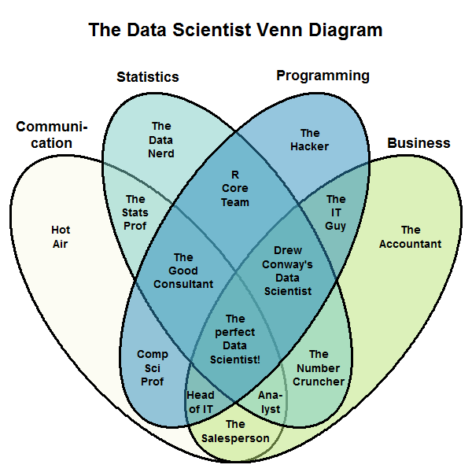
Source: Stephan Kolassa
Notes:
http://drewconway.com/zia/2013/3/26/the-data-science-venn-diagram
https://datascience.stackexchange.com/questions/2403/data-science-without-knowledge-of-a-specific-topic-is-it-worth-pursuing-as-a-ca

Slide 14
What is Data Science?
Data science, also known as data-driven science, is an interdisciplinary field of scientific methods, processes, algorithms and systems to extract knowledge or insights from data in various forms, either structured or unstructured, similar to data mining.
Data science is a "concept to unify statistics, data analysis, machine learning and their related methods" in order to "understand and analyse actual phenomena" with data.
Source: Wikipedia
Notes:
https://dzone.com/articles/data-science-vs-data-analysis-whats-the-difference
https://hbr.org/2012/10/data-scientist-the-sexiest-job-of-the-21st-century

Slide 15
Machine Learning
[Machine Learning is the] field of study that gives computers the ability to learn without being explicitly programmed.
Arthur Samuel, 1959

Slide 16
Why Machine Learning?
Set rules versus ML
E.g., Spam filtering
ML is great for:
Problems the requires a lot of hand-tuning or long list of rules
Complex problems
Evolving environment: Adapts to new data
Pattern discovery / Provides insights
Good Resource: McKinsey’s An executive’s guide to AI

Slide 17
Types of Machine Learning Algorithms – When to use it?
Supervised
You know how to classify the input data and the type of behaviour you want to predict, but you need the algorithm to calculate it for you on new data
Unsupervised
You do not know how to classify the data, and you want the algorithm to find patterns and classify the data for you
Reinforcement Learning
You don’t have a lot of training data; you cannot clearly define the ideal end state; or the only way to learn about the environment is to interact with it
Source: McKinsey’s An executive’s guide to AI

Slide 18
Types of Machine Learning Algorithms
Supervised
Regression
Linear Regression, Penalised Methods, Tree based
Classification
Logistic Regression, Tree based, Bagging, Boosting
Unsupervised
Clustering
Visualisation / Dimensionality Reduction
Association rule learning
Semi-supervised
Reinforcement Learning
Good Resource: McKinsey’s An executive’s guide to AI

Slide 19

Reinforcement Learning - 2015

Slide 20
Supervised Learning – Use Case
Source: McKinsey’s An executive’s guide to AI

Slide 21
Machine Learning Algorithms

Slide 22

Source: Nvidia https://bit.ly/2aoQwIx

Slide 23

Source: http://scikit-learn.org/stable/tutorial/machine_learning_map/index.html

Slide 24
Machine Learning in Finance
Supervised Machine Learning

Slide 25
Credit Scoring

Slide 26
Credit Scoring
Statistical forecast of individual credit risk
To objectively evaluate creditworthiness of borrowers
Ability
Willingness
Used by lenders in
Loan approval
Evaluating risk based charge (E.g., interest rate benchmark + margin)
Source: WPS Analytics
Notes:
https://www.worldprogramming.com/blog/credit_scoring_development_pt1
https://www.quora.com/What-is-the-purpose-of-a-credit-score

Slide 27
Traditional Credit Scoring
Performed by loan manager
5Cs
Character
Capital – deposit and loan quantum
Collateral – Security being offered
Capacity – Repaying ability
Condition – Macroeconomic consideration
Shortcomings:
Subject to human emotion
Decisions lacked consistency / difficult to replicate
No set process & difficult to formalise
Not scalable
Source: Credit Scoring Using Machine Learning, https://arrow.dit.ie/sciendoc/137/
Notes:
Credit Scoring Using Machine Learning. Kenneth Kennedy. Dublin Institute of Technology

Slide 28
Credit Scoring
Regulations drove the need for a more objective and transparent process
Equal Credit Opportunity Act (ECOA) 1974
Prohibits a creditor from discriminating against an applicant on the basis of race, colour, religion, national origin, and sex.
Statistically credit scoring systems were proposed
The US Federal Reserve’s Regulation B1 (Section 202.2) required that credit scoring systems must be, amongst other things:
based on data that are derived from an empirical comparison of sample groups or the population of creditworthy and noncreditworthy applicants who applied for credit within a reasonable preceding period of time
Developed and validated using accepted statistical principles and methodology
Source: Credit Scoring Using Machine Learning, https://arrow.dit.ie/sciendoc/137/
Notes:
Credit Scoring Using Machine Learning. Kenneth Kennedy. Dublin Institute of Technology

Slide 29
Credit Scoring
Empirically derived and other credit scoring systems
A credit scoring system is a system that evaluates an applicant’s creditworthiness
Mechanically
Based on key attributes of the applicant
Aspects of the transaction
Information about the applicant
To qualify as an empirically derived, demonstrably and statistically sound, credit scoring system, the system must be:
Based on data that are derived from an empirical comparison of sample groups or the population of creditworthy and non-creditworthy applicants who applied for credit within a reasonable preceding period of time
Developed for the purpose of evaluating the creditworthiness of applicants
Developed and validated using accepted statistical principles and methodology
Periodically revalidated to maintain predictive ability.
Source: Credit Scoring Using Machine Learning, https://arrow.dit.ie/sciendoc/137/
Notes:
Credit Scoring Using Machine Learning. Kenneth Kennedy. Dublin Institute of Technology

Slide 30
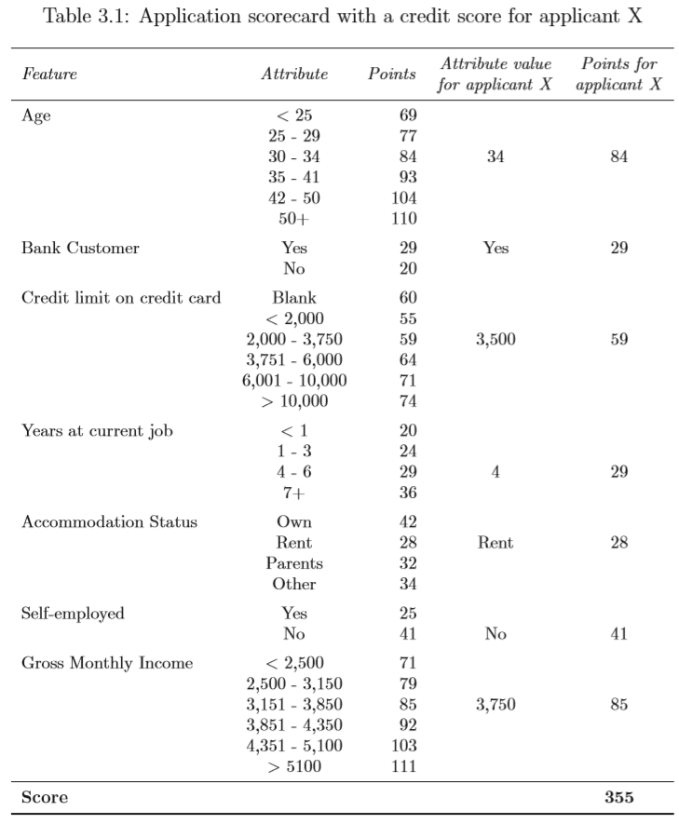
Credit Scoring
Source: Credit Scoring Using Machine Learning. Kenneth Kennedy. https://arrow.dit.ie/sciendoc/137/

Slide 31
Scorecard Model Development
Data Quality
Accuracy – degree of precision of measurements of a feature to its true value
Completeness – the extent to which values are missing in the data
Consistency – multiple data sources are used and due to a lack of standardisation, two or more data items may conﬂict with each other
Data discretisation / classing
Feature selection
Train / Test dataset
Model development and validation
Source: Building a Scorecard in Practice, https://bit.ly/2iKyw4n
Notes:
https://en.wikipedia.org/wiki/Credit_scorecards

Slide 32
Common Models
Logistic regression
Most commonly used algorithm within the consumer credit scoring industry
Supervised ML
Linear Discriminant Analysis (LDA)
Support Vector Machine
Neural Network
Decision Tree
Random forests

Slide 33

Alternative

Slide 34
Alternative Data
Utilities (gas, water, electricity)
Telecom (TV, mobile, broadband)
Rent
Property/asset record: including value of owned assets
Public records: beyond the limited public records information already found in standard credit reports
Alternative lending payments (e.g., payday, instalment loan, rent-to-own, buy-here-pay-here auto loans, auto title loans): including both on-time and derogatory payment data
Demand deposit account (DDA) information: including recurring payroll deposits and payments, average balance, etc.
Source: Alternative Data and the Unbanked https://owy.mn/2Gxwwn7

Slide 35
Alternative Data
Transaction Data
Telecom / Rent / Utility Data
Social Profile Data
Social Network Data
Clickstream Data
Audio and Text Data
Survey Data
Mobile App Data
Source: http://www.fico.com/en/blogs/analytics-optimization/using-alternative-data-in-credit-risk-modeling/
Notes:
http://www.fico.com/en/blogs/analytics-optimization/using-alternative-data-in-credit-risk-modeling/
http://www.fico.com/en/blogs/analytics-optimization/how-to-build-credit-risk-models-using-ai-and-machine-learning/

Slide 36
Transaction Data
How customers use their credit or debit cards.
Not often mined to extract the maximum predictive value.
Can be used to generate a wide range of predictive characteristics
Ratios of Cash to Total Spend in last X week(s)
Ratios of Spend in last X week(s) to last Y week(s)
Characteristics based on
Number
Frequency
Value of transactions at different retailer types
Source: http://www.fico.com/en/blogs/analytics-optimization/using-alternative-data-in-credit-risk-modeling/

Slide 37
Social Profile Data
Facebook, LinkedIn, Twitter, Instagram, Snapchat or other social media sites
Concerns:
Regulatory hurdles
Privacy issues
Easy to manipulate
Source: http://www.fico.com/en/blogs/analytics-optimization/using-alternative-data-in-credit-risk-modeling/

Slide 38
Social Network Analysis
Map a consumer’s network
Identify all the files and accounts for a single customer
Identify the individual’s connections with other people
Especially useful when evaluating a new credit applicant with no or little credit history. The credit ratings of the applicant’s network can provide useful information.
Potential regulatory issue
Source: http://www.fico.com/en/blogs/analytics-optimization/using-alternative-data-in-credit-risk-modeling/

Slide 39
Other Data Sources
Clickstream Data.
How a customer moves through your website, where they click and how long they take on a page can be predictive.
Audio and Text Data.
Information found on credit applications
In recorded customer service or collections calls.
Complement “thin files” / lacked credit history
Source: http://www.fico.com/en/blogs/analytics-optimization/using-alternative-data-in-credit-risk-modeling/

Slide 40
“Alternative”
Data showing trends or patterns in traditional loan repayment data.
Payment data relating to non-loan products requiring regular (typically monthly) payments, such as telecommunications, rent, insurance, or utilities.
Checking account transaction and cashflow data and information about a consumer’s assets, which could include the regularity of a consumer’s cash inflows and outflows, or information about prior income or expense shocks.
Source: https://files.consumerfinance.gov/f/documents/20170214_cfpb_Alt-Data-RFI.pdf

Slide 41
“Alternative”
Data that some consider to be related to a consumer’s stability, which might include information about the frequency of changes in residences, employment, phone numbers or e-mail addresses.
Data about a consumer’s educational or occupational attainment, including information about schools attended, degrees obtained, and job positions held.
Behavioural data about consumers, such as how consumers interact with a web interface or answer specific questions, or data about how they shop, browse, use devices, or move about their daily lives.
Data about consumers’ friends and associates, including data about connections on social media.
Source: https://files.consumerfinance.gov/f/documents/20170214_cfpb_Alt-Data-RFI.pdf

Slide 42
Characteristics of Good Alternative Data
Coverage: a new data source will ideally have broad and consistent coverage
Specificity: a data source should ideally contain detailed data elements about an individual – data elements that provide part of a full picture of the borrower (e.g., ontime and late payments over a significant time series, or specific asset or income data)
Accuracy and timeliness: data should be accurate and frequently updated
Predictive power (‘signal’): most important, data should contain information relevant to the behaviour that you’re trying to predict
Orthogonality: ideally, the data source should be additive to traditional bureau data; this means that using it will improve the predictive accuracy of any new score by improving the signal-to-noise ratio
Regulatory compliance: data sources must comply with existing regulations for consumer credit (i.e., Fair Credit Reporting Act, Equal Credit Opportunity Act, Gramm-Leach-Bliley Act)
Source: Alternative Data and the Unbanked https://owy.mn/2Gxwwn7

Slide 43
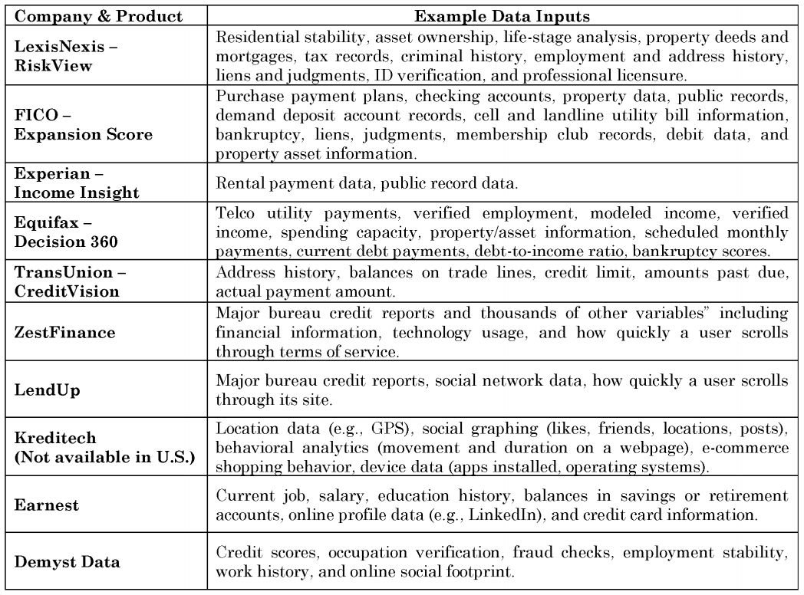
Source: Credit Scoring in The Era of Big Data, https://bit.ly/2vdxhi9

Slide 44
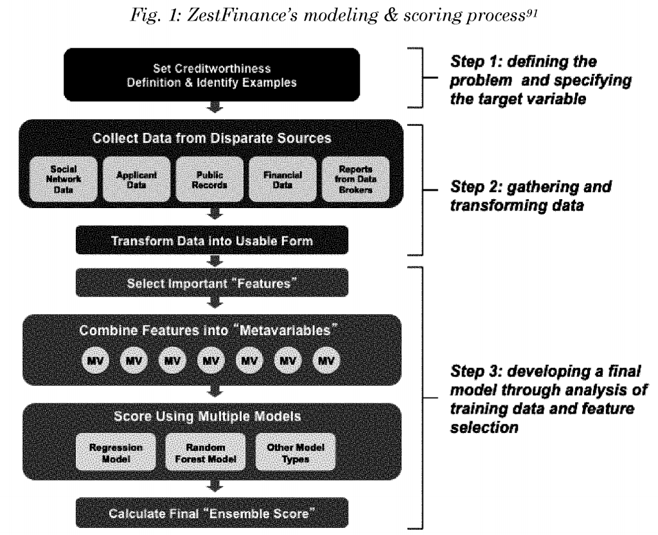
Source: Credit Scoring in The Era of Big Data, https://bit.ly/2vdxhi9

Slide 45
Churn Prediction
Linear / Quadratic Discriminant Analysis

Slide 46
What is Churn?
Also called customer attrition / turnover / defection
The loss of clients or customers
Notes:
https://docs.microsoft.com/en-us/azure/machine-learning/studio/azure-ml-customer-churn-scenario
https://www.kdnuggets.com/2017/03/datascience-building-predictive-churn-model.html
https://aws.amazon.com/blogs/machine-learning/predicting-customer-churn-with-amazon-machine-learning/
https://towardsdatascience.com/churn-prediction-with-machine-learning-e6612cd5538f
https://tensorflow.rstudio.com/blog/keras-customer-churn.html
https://www.kaggle.com/mainakdatageek/churn-prediction-machine-learning-starter
https://www.h2o.ai/wp-content/uploads/2017/03/Case-Studies_PayPal.pdf
https://en.wikipedia.org/wiki/Customer_attrition
https://www.researchgate.net/profile/Konstantinos_Chatzisavvas/publication/273439405_A_Comparison_of_Machine_Learning_Techniques_for_Customer_Churn_Prediction/links/574edb0008aec50945bb3e95/A-Comparison-of-Machine-Learning-Techniques-for-Customer-Churn-Prediction.pdf
https://www.indecs.eu/2016/indecs2016-pp116-124.pdf
https://content.pivotal.io/blog/churn-prediction-in-retail-finance-and-asset-management-part-1
https://www.mckinsey.com/industries/telecommunications/our-insights/reducing-churn-in-telecom-through-advanced-analytics
http://www.hbs.edu/faculty/Publication%20Files/14-020_3553a2f4-8c7b-44e6-9711-f75dd56f624e.pdf
Prediction Solutions
https://jfin-swufe.springeropen.com/articles/10.1186/s40854-016-0029-6
https://pdfs.semanticscholar.org/0890/20f8ee2a269f523d5fec62819f6e264aac6e.pdf
https://tensorflow.rstudio.com/blog/keras-customer-churn.html
https://www.kaggle.com/mainakdatageek/churn-prediction-machine-learning-starter

Slide 47
Benefits of Customer Retention
Successful customer retention lowers the need for seeking new and potentially risky customers, and allows organisations to focus more accurately on the needs of their existing customers by building relationships
Long-term customers buy more and, if satisfied, may provide new referrals through positive word-of-mouth for the company
Long-term customers become less costly to serve due to the bank’s greater knowledge of the existing customer and to decreased servicing costs
They tend to be less sensitive to competitive marketing activities
Losing customers not only leads to opportunity costs because of reduced sales, but also to an increased need for attracting new customers, which is five to six times more expensive than customer retention
Source: Dirk Van den Poel, et. al. Customer Attrition Analysis For Financial Services Using Proportional Hazard Models.
Notes:
Successful customer retention lowers the need for seeking new and potentially risky customers, and allows organisations to focus more accurately on the needs of their existing customers by building relationships (Dawes and Swailes, 1999; Engel et al, 1995);
Long-term customers buy more (Paulin et al, 1998; Ganesh et al, 2000) and, if satisfied, may provide new referrals through positive word-of-mouth for the company (Ganesh et al, 2000; Colgate et al, 1996);
Long-term customers become less costly to serve due to the bank’s greater knowledge of the existing customer and to decreased servicing costs (Ganesh et al, 2000; Paulin et al, 1998);
They tend to be less sensitive to competitive marketing activities (Colgate et al, 1996);
Losing customers not only leads to opportunity costs because of reduced sales, but also to an increased need for attracting new customers (Athanassopoulus, 2000), which is five to six times more expensive than customer retention (Bhattacharya, 1998; Colgate and Danaher, 2000; Rasmusson, 1999).

Slide 48
Machine Learning in Finance
Unsupervised Machine Learning

Slide 49
Customer Segmentation
K-Means Clustering

Slide 50
Machine Learning in Finance
Algorithmic Trading and Portfolio Allocation

Slide 51
Algorithmic Trading

Slide 52
What is Algorithmic Trading?
Covered the method of execution large orders by breaking them to small trade size and filling them without significantly moving the market.
Systematic trading with set rules in the form of algorithm(s) and little or no human intervention with a profit objective.

Slide 53
Pairs Trading as a Motivational Example
Market neutral trading strategy
Uncorrelated with the market return. In CAPM terminology, beta is zero or near zero
Profit in all market conditions
Constructed with only two assets
Concurrently long and short

Slide 54
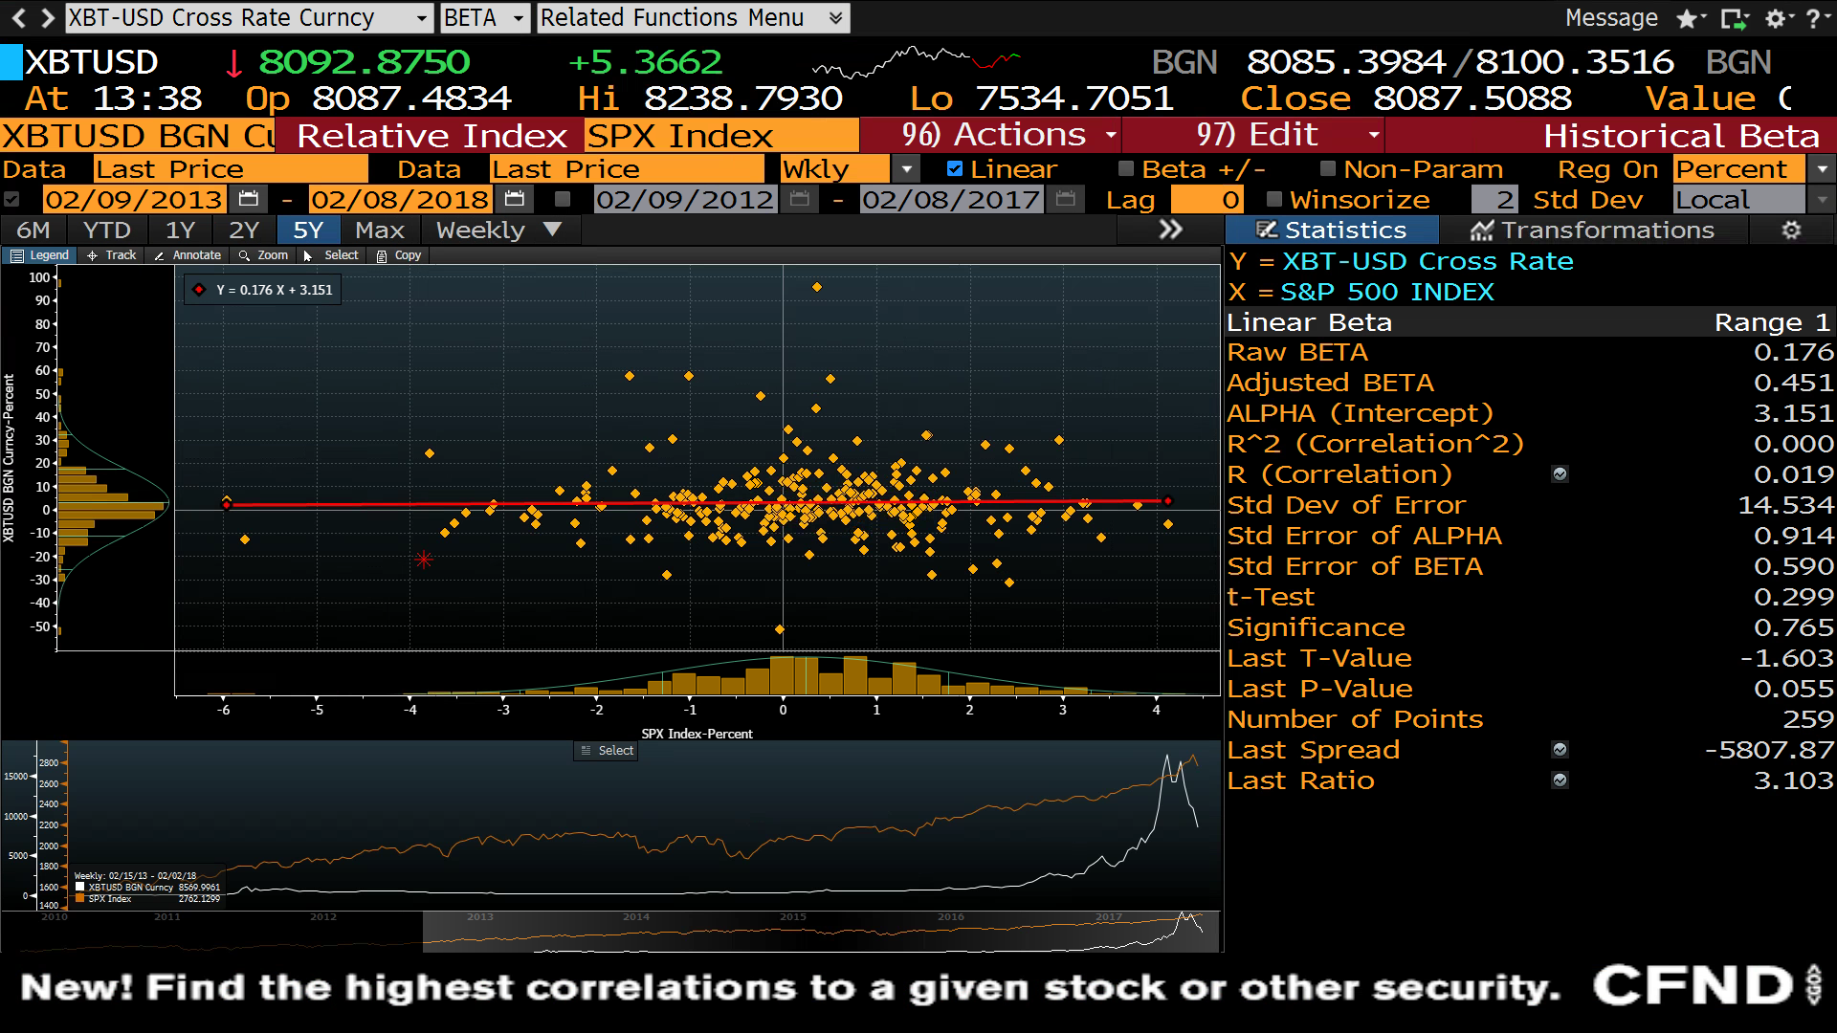

Slide 55
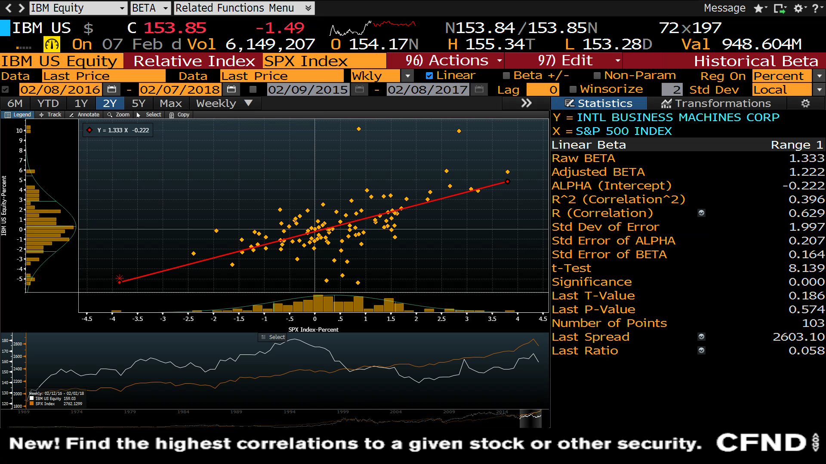

Slide 56
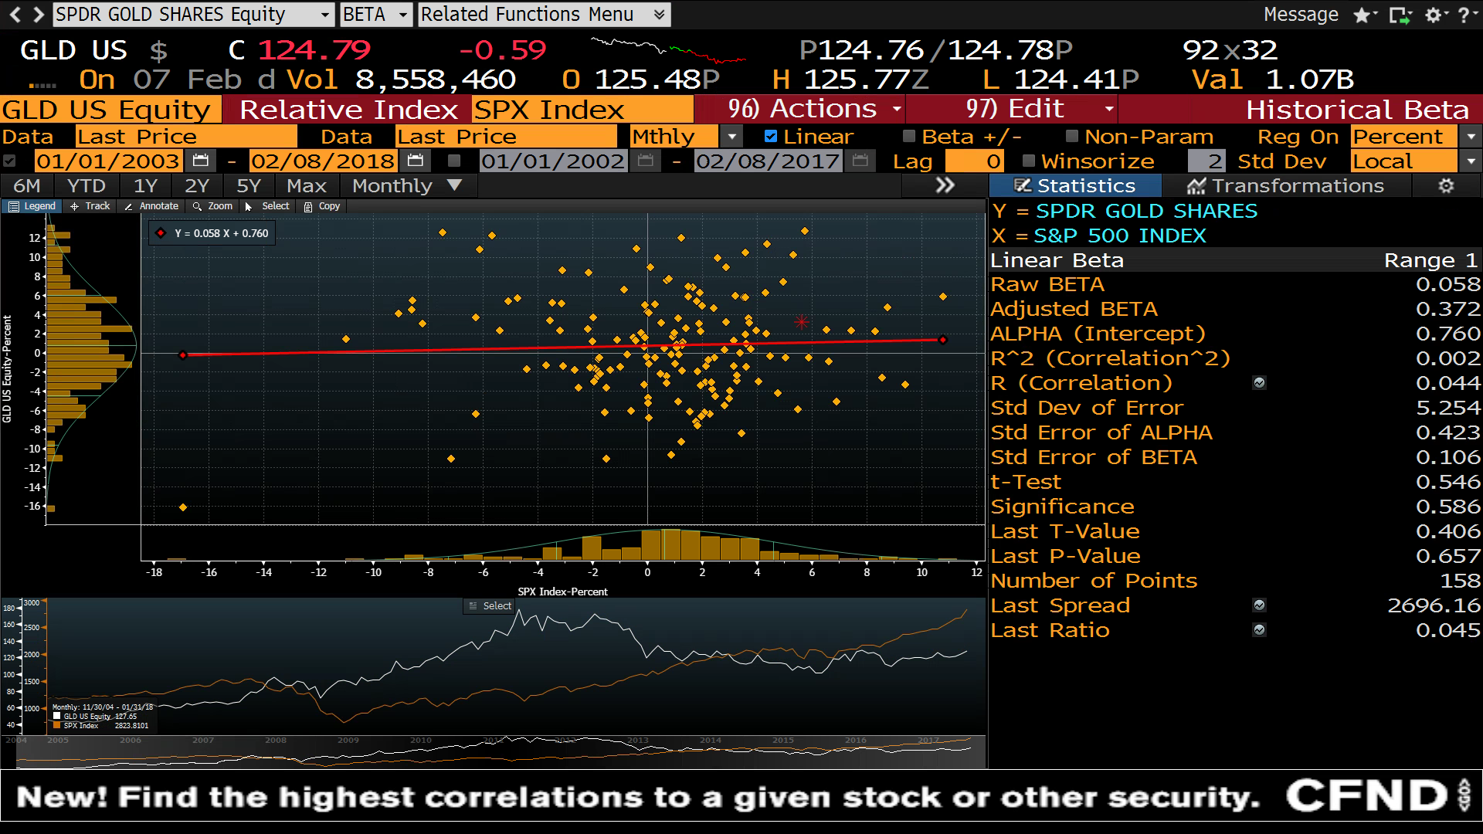

Slide 57
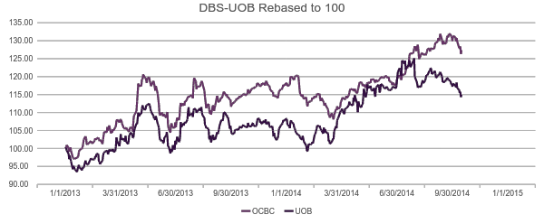
Simple Pairs Trading Example

Slide 58
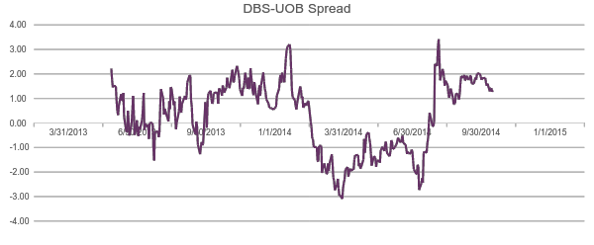
Simple Pairs Trading Example

Slide 59
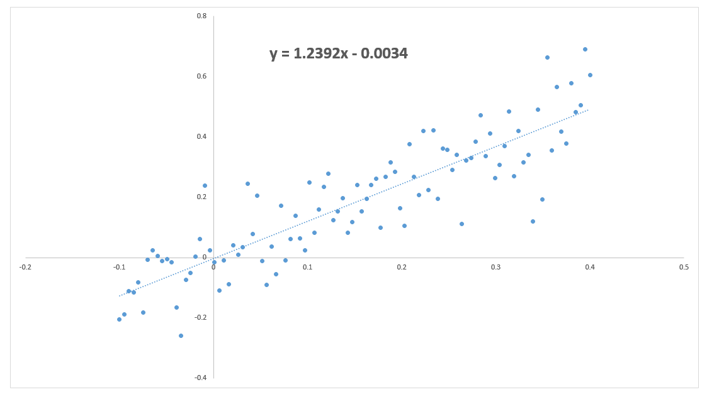
Performance Metrics
Total Returns
Benchmark Returns
Volatility
Sharpe Ratio
(Risk Premium) / SD

Slide 60
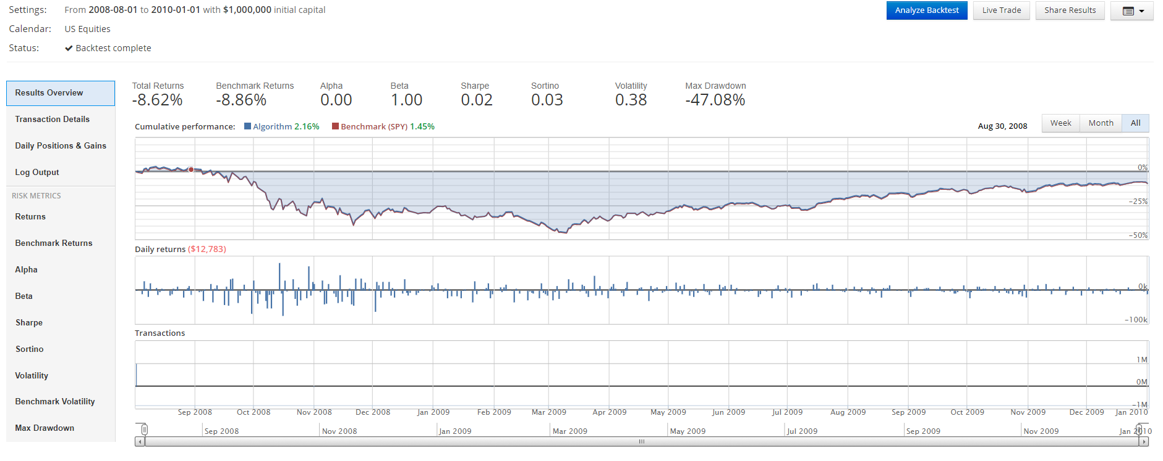
Benchmark – Long Only SPY

Slide 61
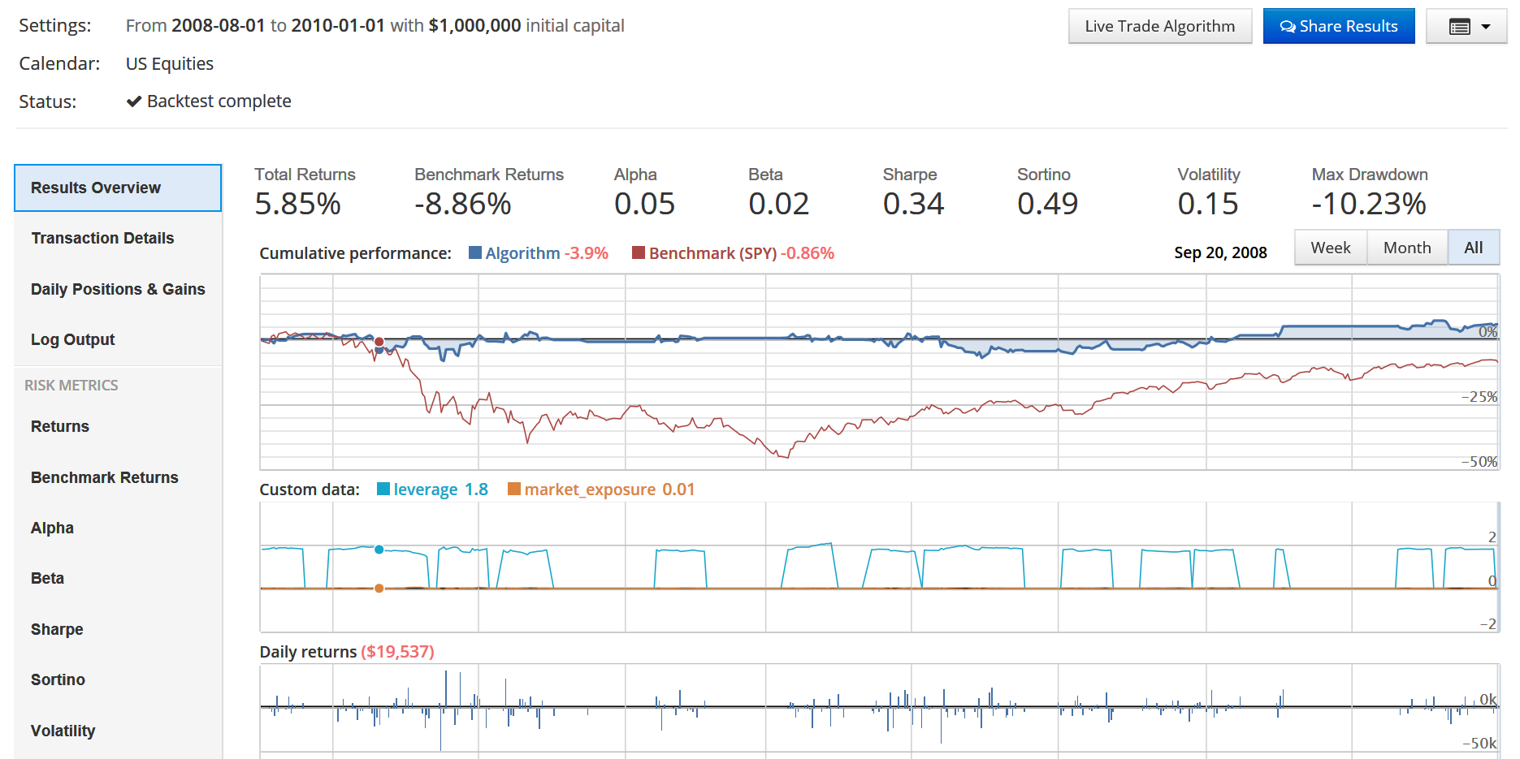
Pairs Trading Backtest Example
 | SPY | Pairs
Total Returns | -8.62% | 5.85%
Sharpe | 0.02 | 0.34
Volatility | 38% | 15%
Max Drawdown | -47% | -10%

Slide 62
Pairs Trading Technology
Distance Method
Cointegration Method
Linear Regression
Penalised Regression – Ridge, Lasso, ElasticNet
Kalman Filters
Cointegrated Augmented Dickey Fuller
Companies similarity
Clustering
Sentiment based
Market Regime Detection
Hidden Markov Models
RNN / LSTM
Reinforcement Learning

Slide 63
Quant Workflow
Data
Universe Definition
Alpha Discovery
Alpha Combination
Portfolio Construction
Trading

Slide 64
Factor Based Investing
Exposure to factor risk earns a risk premium
Types of Factors
Macroeconomic Factors: Growth, Inflation, Political Risk, etc.
Static Factors: Equities, Bonds, etc.
Dynamic Factors: Value-Growth, Momentum, Low Volatility, Size, Liquidity, Credit Risk, etc.
CAPM
Single Factor: Market Factor
Multifactor Models:
Fama-French:
Market
Size (Small [Market Capitalisation] Minus Big)
Book/Price (High pbook-to-market] Minus Low). High book-to-market = value stocks.
$r_{i}=r_{f}+β_{M}\left( r_{M}−r_{f}\right)+β_{SMB}SMB+β_{HML}HML+α$
Both SMB and HML are zero-cost portfolios. That’s another term for dollar neutral.
Notes:
https://en.wikipedia.org/wiki/Fama%E2%80%93French_three-factor_model

Slide 65
Benchmark – Long Only SPY

Slide 66
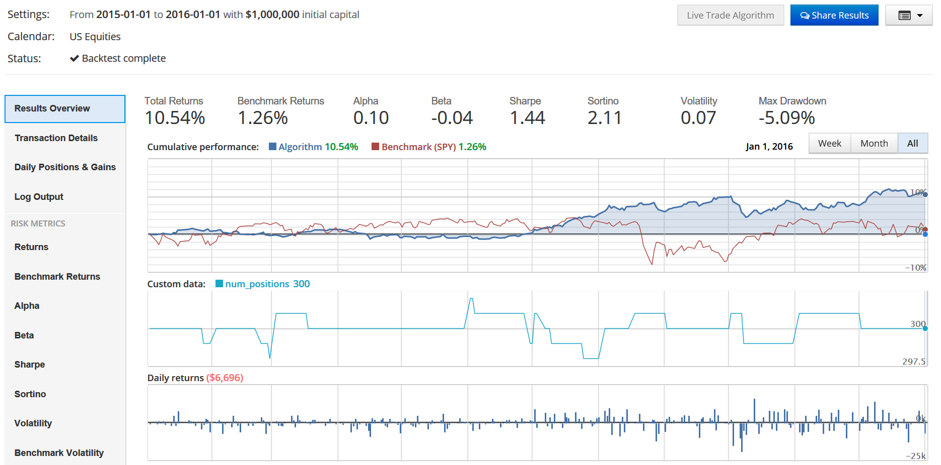
Long-Short Backtest Example
 | SPY | L/S
Total Returns | 0.33% | 10.54%
Sharpe | 0.10 | 1.44
Volatility | 16% | 7%
Max Drawdown | -11.8% | -5%

Slide 67
Factor Based Technology
Factor identifications
Deep learning
Alternative datasets
Slides (https://slides.com/anthonytyng/alternative_data/live)
Video (https://youtu.be/6GUKFoZKf5I)
Consumer transaction. E.g., POS data
Social Media / Sentiment
Online search
IoT
Satellite & Weather
etc.

Slide 68

Survey Link: https://tinyurl.com/y38d2tvr
Course Title: Machine Learning in Finance
Course Start Date: 24 May 2019
Name of Trainer(s): Anthony Ng

